Slide 1

Попълнете следните изречения като използвате
some
или
any

Slide 2
Запомнете!
Използваме some в положителни изречения и когато питаме с:
”Can” или “Would” :
I’ve got some good friends.
Would you like some tea?
Can I have some cake, please?

Slide 3
Запомнете:
Използваме any във въпроси и отрицателни изречения:
I haven’t got any mistakes.
She hasn’t got any sisters.
Have they got any apples?

Slide 4
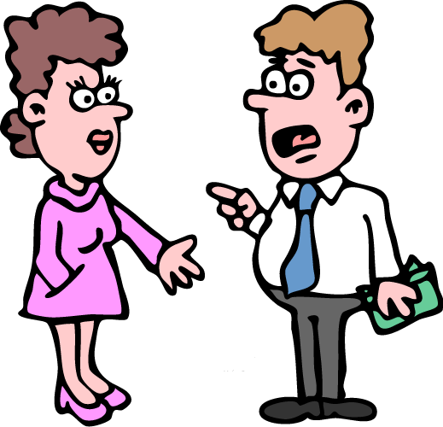
some
I’ve got ………. money.

Slide 5
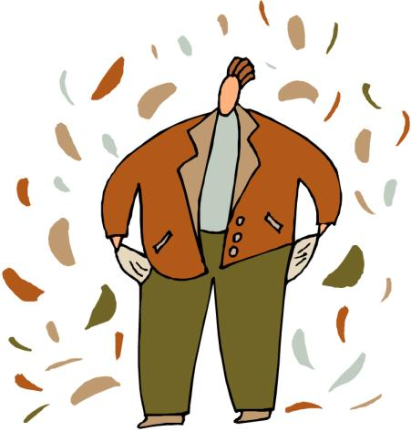
any
He hasn’t got ……. money.

Slide 6
Have Bob and Sam
got …... children?
any

Slide 7
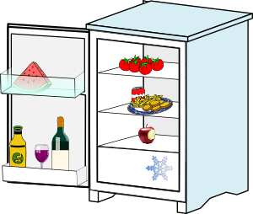
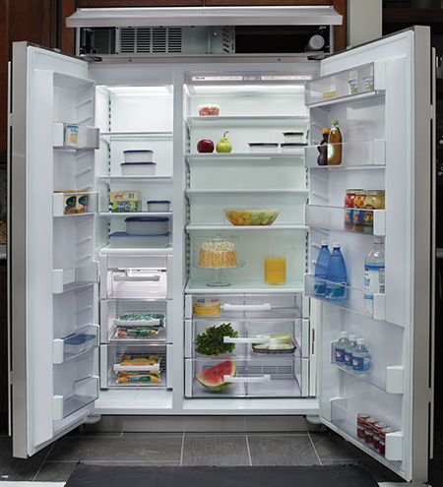
any
There isn’t ……. bread
in the fridge.

Slide 8
X
some
I’ve got ………. cheese
but I haven’t got …… bread.
any

Slide 9
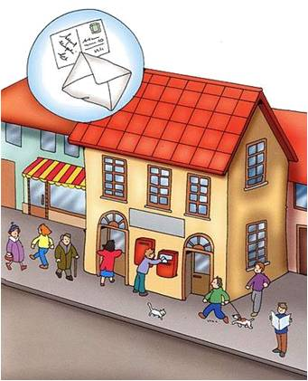
I’m going to the post office.
I need ………. stamps.
some

Slide 10
X
any
There aren’t .….. shops
in this part of town.

Slide 11
Have you got
…….. children?
any

Slide 12
some
There are ……... beautiful flowers in the garden.

Slide 13
any
Do you know ….… good
hotels in London?

Slide 14
Would you like
……….. tea?
some

Slide 15
any
Don’t buy ……… rice.
We don’t need ……..
any

Slide 16

some
I wanted to buy ………. oranges, but they didn’t have
……… in the shop.
any

Slide 17
I’m thirsty. Can I have
……… water, please?
some

Slide 18

some
Let’s listen to ………. music and have ………. tea.
some

Slide 19
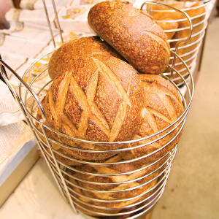
some
We need ……… bread
for dinner.

Slide 20
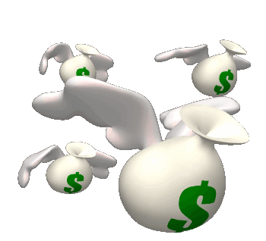
The children went out without …….. money.
any

Slide 21
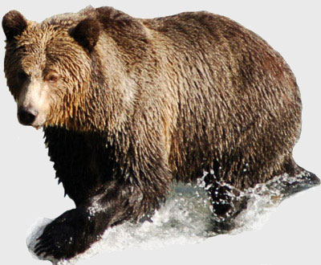
Have you seen
……….. bears?
any

Slide 22

some
Let’s buy ………..
postcards!

Slide 23
Thanks
for
your attention!

