Slide 1
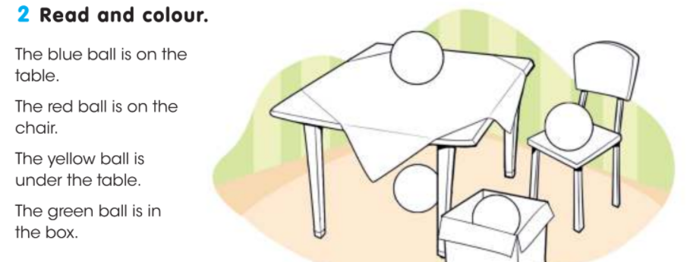
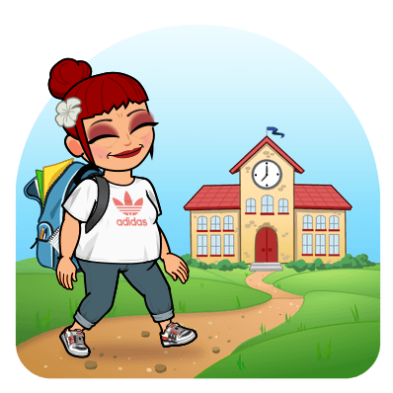
Entrance level, – 3rd grade
Name…………………………………………………….………………………...class……….Group 1
1.Listen and colour 2.Circle a/an then complete
blue, green, black, yellow, red
It’s a/an apple. It’s _______ .
It’s a/an pencil case. It’s ________ .
It’s a/an book. It’s __________ .
It’s a/an school bag. It’s __________.
It’s a/an umbrella. It’s __________ .
___/5p.
___/10p.
3.Write the missing letters
ei_ht 8 ; ru_ _er ; he_ _o ; nin__ 9; Hh Ii _ _ Kk Ll
___/5p.
4.Read and colour 5.Circle the correct form
am/is/are
dd
It am/is/are a pen.
He am/is/are my friend.
They am/is/are happy.
We am/is/are at school.
You am/is/are my sister.
I am/is/are nine.
___/8p.
___/6p.
6.Match the questions to the answers
What’s your name? A. Yes, I can.
How old are you? B. No, I haven’t.
Have you got a pet? C. They are bananas.
How are you? D. I’m nine.
What’s your favourite food? E. It’s blue.
What’s your favourite colour? F. I’m fine, thanks!
Can you jump? G. My name is Maria.
Are you ready for school? H. Yes, I am.
1__, 2__, 3__, 4__, 5__, 6__, 7__, 8__
Total: ___/42p.
42p.-36p. Excellent
35p.-28p. Very good
27p.-22p. Good
21p.-15p. Fair
14p.-0p. Poor
___/8p.

Slide 2
Entrance level – 3rd grade
Name…………………………………………………………………………………....class…..…. Group 2
1.Listen and colour 2.Circle a/an then complete
blue, green, black, yellow, red
It’s a/an school bag. It’s __________.
It’s a/an apple. It’s _______ .
It’s a/an pencil case. It’s ________ .
It’s a/an umbrella. It’s __________ .
It’s a/an book. It’s __________ .
___/5p.
___/10p.
3.Write the missing letters
fo _ r 4 ; ru _ er ; G_ _ d bye! ; t _o 2; Jj Kk Ll _ _ Nn
___/5p.
4.Read and colour 5.Circle the correct form
am/is/are
dd
The pink ball is on the table.
The blue ball is in the box.
The green ball is on the chair.
The orange ball is under the table.
It am/is/are a pencil.
She am/is/are my Mum.
We am/is/are happy.
They am/is/are at home.
You am/is/are my friend.
I am/is/are ten.
___/8p.
___/6p.
6.Match the questions to the answers
Are you ready for school? A. Yes, I am.
What’s your name? B. No, I can’t.
How old are you? C. Yes, I have.
Have you got a pet? D. They are bananas.
What’s your favourite food? E. It’s blue.
What’s your favourite colour? F. I’m fine, thanks!
How are you? G. I’m eight.
Can you jump? H. My name is Jake.
1__, 2__, 3__, 4__, 5__, 6__, 7__, 8__
Total: ___/42p.
42p.-36p. Excellent
35p.-28p. Very good
27p.-22p. Good
21p.-15p. Fair
14p.-0p. Poor
___/8p.

